Slide 1
STAT 930: Project Presentation Neetu Regmi

Slide 2
Impact of methionine hydroxy analog supplemented to cows during the last trimester of gestation to evaluate cow reproduction and calf growth

Slide 3
Introduction
The objective was to study the impact of methionine hydroxy analog supplemented to cows during the last trimester of gestation to evaluate cow reproduction and calf growth.
The objective above was driven by some of the findings in previous studies:
Nutritional status during pregnancy plays an important role in offspring development and growth. (Alharthi et al., 2018)
An increase in methionine supplementation during the last trimester of pregnancy as been shown to have positive benefits to fetal growth and growth during weaning periods (Alharthi et al., 2018).

Slide 4
Background about Methionine
Methionine is considered an essential amino acid. It is not naturally created by the animal, and therefore must be consumed in diet
Methionine hydroxy analog has similar chemical structure to that of methionine. (Methionine hydroxy analogue has a hydroxyl group instead of an amine group)

Slide 5
Experimental Design
The experiment was conducted as a three-year study.
Cows were supplemented on winter range (December through February) with one of the five treatments.
Distillers based cube are good source of energy and protein which contains higher percent energy value of corn grain.
These five treatments are:
No supplement (NS)
1lb of a distillers-based cube (T1)
2lb of a distiller-based cube (T2)
2lb of a distillers-based cube plus 30g of Methionine hydroxy analog (MET)
Hay no protein (HAY)

Slide 6
Experimental Design Cont’d
There were 10 pastures. Each pasture is an experimental unit.
There were 11 cows for each treatment allocated to a pasture.
These 11 cows stayed in the same groups and treatments but assigned to different pastures each year.
There were total of 150 cows in each year.
Five treatments were randomly applied to each of the 10 pastures.

Slide 7
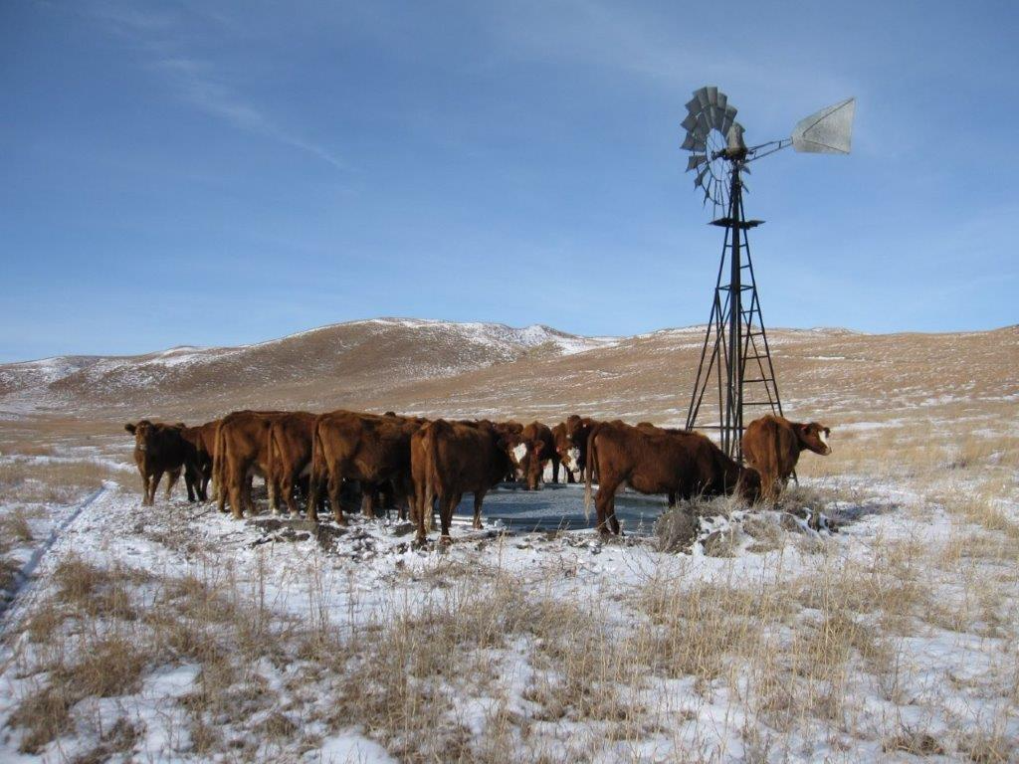
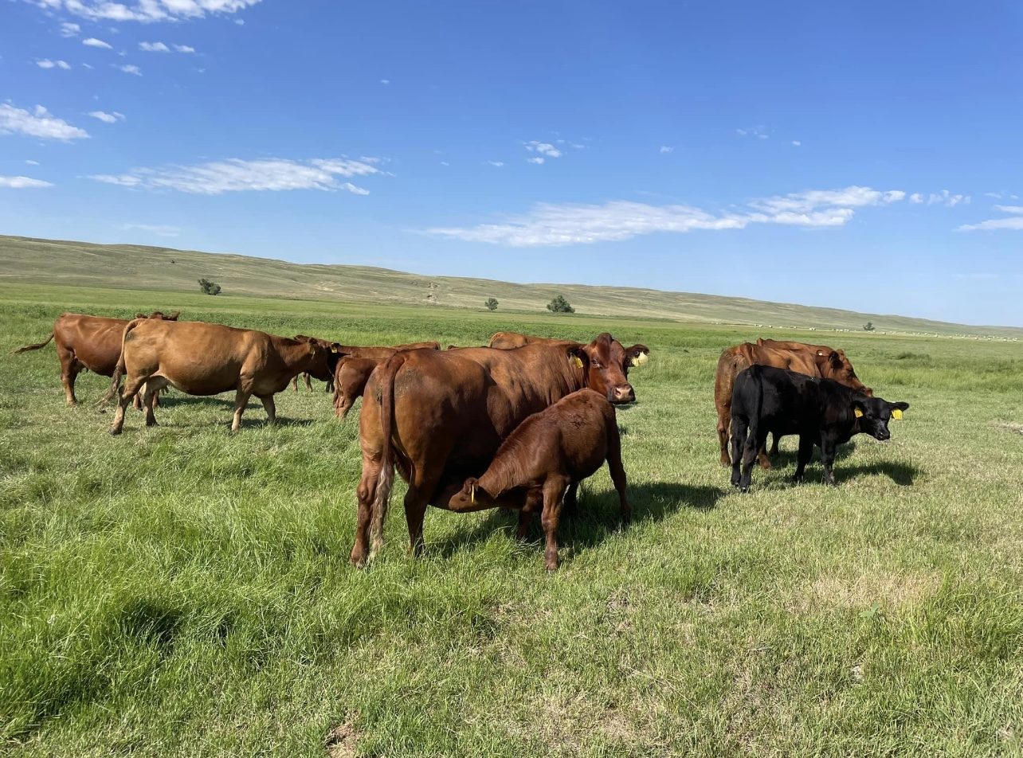
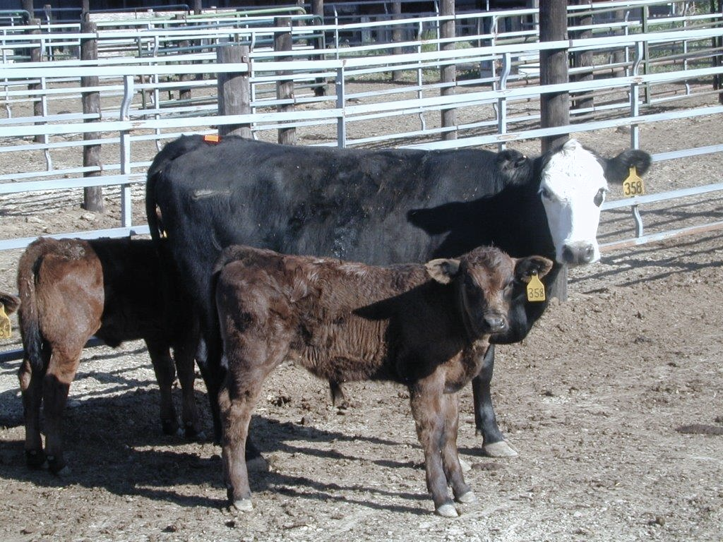
Pictures from location of experiment

Slide 8
Variables of interest
Weight (lbs)
Birth weight of calf
Pre-breed calf weight
Calf wean weight
Cow wean weight
Body conditioning score (BCS)
Pre-calf BCS
Pre-breed BCS
BCS

Slide 9
Variables of interest
Carcass traits
Hot carcass weight (HCWT)
Quality grade (Q grade)
Yield grade (YG)
Ribeye (Rea)
Marbling (Marb)
Backfat (Bkf)
Pregnancy

Slide 10

Statistical Model – (ANCOVA)
Let $y_{ijk}$ denote one of the 12 responses for $i^{th}$ year, $j^{th}$ treatment, (NS, MET, T1, T2, HAY), $k^{th}$sex (Bull or Heifer). Additionally, a baseline measurement day-season (day-season is equal to the calf birthdate minus the first calving season plus one) was taken into account for variables of interest. This is represented by B ($x_{ijk}$ - $\overline{x_{…}})$.
Then, model is
$$y_{ijk} = μ+α_{i}+β_{j}+ {β\left(α\right)}_{\left(i\right)j}+ B \left(x_{ijk} − \overline{x_{…}}\right)+ ε_{ijk}$$
Where:

Slide 11

Statistical Model – (ANCOVA) Cont’d
$μ$ is the overall mean.
${ α}_{i}$ is the effect of the $i^{th}$ year, i = 1, 2, 3
$β_{j}$ is the effect of the $j^{th}$ treatment, j = 1, 2, 3, 4, 5
${ β\left(α\right)}_{\left(i\right)j}$is the random term where $j^{th}$ treatment is nested within $i^{th}$ year.

Slide 12

Statistical Model – (ANCOVA) Cont’d
${β\left(α\right)}_{\left(i\right)j} \sim N(0, σ_{δ}^{2})$
B is the coefficient indicating dependency of $y_{ijk}$ on $x_{ijk}$ and B$≠0$
$x_{ijk}$ is the measurement made on the day season covariate corresponding to $y_{ijk}$
$\overline{x_{…..}}$ is the average of the day season values ($x_{ijk})$
$ε_{ijk}$ is the error term, $ε_{ijk}$ ~ iid N(0, $Σ$) where $Σ$has a covariance structure.

Slide 13

Generalized Linear Mixed Model (GLMM)
For non-normal pregnancy response, a binomial was used with logit link function.
Distribution: $y_{ijk}$| ${β\left(α\right)}_{\left(i\right)j}$ ~ Binomial ($N_{ijk}, π_{ijk})$
Link: logit($π_{ijk}$) = $\log\left(\frac{π_{ijk}}{1−π_{ijk}}\right)$ = $η_{ijk}$where,
$η_{ijk}$ = $μ+α_{i}+β_{j}+ {β\left(α\right)}_{\left(i\right)j}+ B \left(x_{ijk} − \overline{x_{…}}\right)$
The final model had fixed effect of treatment and day-season as covariate with random year*treatment effect. The cows who are not pregnant were dropped along with any repeated measurements.

Slide 14
Weights
The following table indicates the significant p-value of fixed effect for weight variables: Birthweight of calf, Pre-breed calf weight, Calf wean weight and Cow wean weight.
Weight Variables | Fixed effects
 | Year | Treatment | Sex | Day-season
Birthweight of calf | 0.0276 | 0.2183 | <.0001 | 0.2380
Prebreed calf weight | 0.0006 | 0.0145 | <.0001 | <.0001
Cow wean weight | 0.0050 | 0.4278 | 0.9630 | 0.2793
Calf wean weight | 0.0045 | 0.0297 | <.0001 | <.0001

Slide 15
Plots

Slide 16
Estimates table
The table below indicates estimated mean of weight variables across different treatments. T2 treatment leads to larger weight for pre-breed calf and cow wean weight whereas Hay treatment leads to larger weight in calf at birth and when calf is weaned.
Weight Variables | Treatments
 | NS | T1 | T2 | MET | HAY
Birthweight of calf | 71.20 | 76.43 | 76.47 | 74.25 | 76.95
Prebreed calf weight | 137.97 | 156.70 | 161.30 | 151.64 | 160.62
Cow wean weight | 1087.58 | 1055.84 | 1116.39 | 1039.90 | 1115.54
Calf wean weight | 464.70 | 493.30 | 507.98 | 486.56 | 511.54

Slide 17
Body Conditioning Score (BCS)
The body conditioning score describe the relative fatness or body composition of cow.
The scoring system ranges of 1 to 9.
1 represent thin cows
5 represent average cow
9 represent fat cow
Dec BCS is the body conditioning score of cows before the treatments were fed.
The primary interest is change in BCS score from Dec BCS.

Slide 18
Plot
The treatment has significant effect for change in body conditioning score from pre calf BCS to Dec BCS (p-value < 0.0001). The treatment differences that were significant are all the treatments in comparison with NS

Slide 19
Estimates table
The treatment differences that were significant are all the treatments in comparison with NS. We see the biggest change in estimate for body conditioning score was for T2 treatment (0.07459) followed by Hay (0.06379)
BCS Variables | Treatments
 | NS | T1 | T2 | MET | HAY
Precalf -decBCS | -0.7564 | -0.2002 | 0.07459 | 0.03410 | 0.06379
Prebreed -decBCS | -0.6698 | 0.4082 | 0.3005 | -0.2822 | -0.05546
BCS - decbcs | -0.1832 | -0.3085 | -0.2695 | -0.2089 | -0.3111

Slide 20
Carcass traits
The findings for the carcass traits showed that there were not any significant treatment effects. The table below indicates point estimates across different treatments for carcass traits.
Weight Variables | Treatments
 | NS | T1 | T2 | MET | HAY
HCWT | 782.07 | 802.60 | 820.56 | 804.36 | 820.99
Probability Q grade | 0.9687 | 0.9459 | 0.9421 | 0.9444 | 0.8154
Yield grade | 2.4709 | 2.7461 | 2.7208 | 2.5614 | 2.6910
Rea | 14.0378 | 13.9569 | 14.5065 | 14.3341 | 14.3267
Marb | 509.27 | 536.81 | 539.50 | 522.14 | 585.52
Bkf | 0.4519 | 0.5175 | 0.5526 | 0.4903 | 0.5131
Notes:
In our dataset, quality grade has three categories prime, select and choice. The binomial distribution was used since the variable was categorized into two options choice vs others. This was based off the frequency table where choice was 156 and prime and select combined was 28. The hay has higher HCWT followed by T2, where no supplement has lowest HCWT. The higher value of ribeye, the better quality. It seems that T2 has highest value followed by MET AND HAY. The hay has a higher marbling score followed by T2 and T1 whereas the lowest is NS. The lower backfat thickness score typically has a higher yield grade. The NS treatment has lower backfat followed by MET.
1 means higher percentage of retail product

Slide 21
Pregnancy
The pregnancy variable was recorded as binary where 1 means cow is pregnant, and 0 means cow is open or not pregnant.
 | Treatments
 | NS | T1 | T2 | MET | HAY
Pregnancy probability | 0.8048 | 0.9449 | 0.9392 | 0.9440 | 0.9415
Pregnancy odds | 4.1216 | 17.1572 | 15.4582 | 16.8699 | 16.0818
Notes:
The probability of success for pregnancy is higher for all three treatments except for NS. The probability of pregnancy is 17 times as large as the probability of not being pregnant for T1 followed closely by Met and Hay.

Slide 22
Plot
There was significant effect of treatment on pregnancy (p-value = 0.0424) and day-season was marginally significant (p-value = 0.0695)
Notes:
The final model had fixed effect of treatment and day-season as covariate with random year*treatment effect. The cows who are not pregnant were dropped along with any repeated measurements.
The cows who are not pregnant were dropped along with any repeated measurements.
There is significant effect of treatment on pregnancy (p-value = 0.0424).

Slide 23
Conclusion
Overall, it turns out that MET treatment does not have any significant impact on our variables of interest.
The treatment was significant for pre calf breed and calf wean weight, but MET was not significantly different in comparison to other treatment.
Hay and T2 treatments seems to have higher estimates in general than MET for the weight.
Year was significant in all carcass traits but the treatments were not significant.

Slide 24
Future work
Future studies could look at treatments with different amount of protein supplementation and methionine hydroxy analog (MFP).
Instead of assigning treatment to the pasture, the treatments could be fed to cows individually.
Increase the number of experimental unit i.e. pastures.
Blocking by weight before the pregnancy of the cow could be done to account for extra variability.
Notes:
To account for trt*weight interaction.

Slide 25
Reflection on STAT 930
Overall, the STAT 930 was a very good learning experience.
Applied aspect that was learned in STAT 821 and STAT 822 (Experimental Design, Linear Mixed Model and Generalized linear Mixed Model)
Develop skillset necessary for consulting and collaboration project as a statistician
Understanding client design of the experiment, dataset and their overarching research questions.
Building communication skills and ability to handle difficult clients (Sometimes having the conversation with client and their advisor and specifying things clearly)
Ability to be open to figure out complicated design and analysis (sometimes it may take longer time than expected) and continue to work and persevere.

Slide 26
Literature Review
Alharthi, A.S. et al. (2018) ‘Maternal supply of methionine during late-pregnancy enhances rate of Holstein calf development in utero and postnatal growth to a greater extent than Colostrum source’, Journal of Animal Science and Biotechnology, 9(1). doi:10.1186/s40104-018-0298-1.
Funston, R.N., Summers, A.F. and Roberts, A.J. (2012) ‘Alpharma Beef Cattle Nutrition Symposium: Implications of Nutritional Management for beef cow-calf systems1’, Journal of Animal Science, 90(7), pp. 2301–2307. doi:10.2527/jas.2011-4568.
Izquierdo, V. et al. (2022) ‘Frequency of maternal supplementation of energy and protein during late gestation modulates preweaning growth of their beef offspring’, Translational Animal Science, 6(3). doi:10.1093/tas/txac110.
Junior, V.C. et al. (2020) Effects of rumen-protected methionine supplementation on the performance of High Production Dairy Cows in the Tropics [Preprint]. doi:10.1101/2020.12.02.407908.
Overton, T.R. et al. (1996) ‘Evaluation of a ruminally protected methionine product for Lactating Dairy Cows’, Journal of Dairy Science, 79(4), pp. 631–638. doi:10.3168/jds.s0022-0302(96)76408-1.
Palmer, E.A. et al. (2020) ‘Maternal supplement type and methionine hydroxy analogue fortification effects on performance of Bos indicus-influenced beef cows and their offspring’, Livestock Science, 240, p. 104176. doi:10.1016/j.livsci.2020.104176.
Silva, G.M. et al. (2021) ‘Effect of rumen-protected methionine supplementation to beef cows during the periconception period on performance of cows, calves, and subsequent offspring’, Animal, 15(1), p. 100055. doi:10.1016/j.animal.2020.100055.
Summers, A.F., Blair, A.D. and Funston, R.N. (2015) ‘Impact of supplemental protein source offered to primiparous heifers during gestation on II. progeny performance and carcass characteristics’, Journal of Animal Science, 93(4), pp. 1871–1880. doi:10.2527/jas.2014-8297.
Stroup, W.W. (2019) Generalized linear mixed models: Modern concepts, methods and applications. Strand, London: CHAPMAN & HALL CRC.
Stroup, W.W. et al. (2018) SAS for mixed models: Introduction and Basic Applications. Cary, NC: SAS.

Slide 27
Questions?? Thank you for your time! ☺

